Slide 1
Hotel Recommendation System
By Mining Text Reviews
CSC 869 - Term Project
Girish M. Tiwale
San Francisco State University, Spring 2018
Advisor: Prof. Hui Yang

Slide 2
Agenda
Data set
Approach
Results
Evaluation
Analysis & Drawbacks
Improvements
References
1

Slide 3
Data Set
Scrapped data available at Kaggle & owned by booking.com
Latest Version - 571,930 reviews of 1490 hotels
Scraped by Jason Liu
Hotel name, Negative Review, Positive Review, Rating etc.

Slide 4
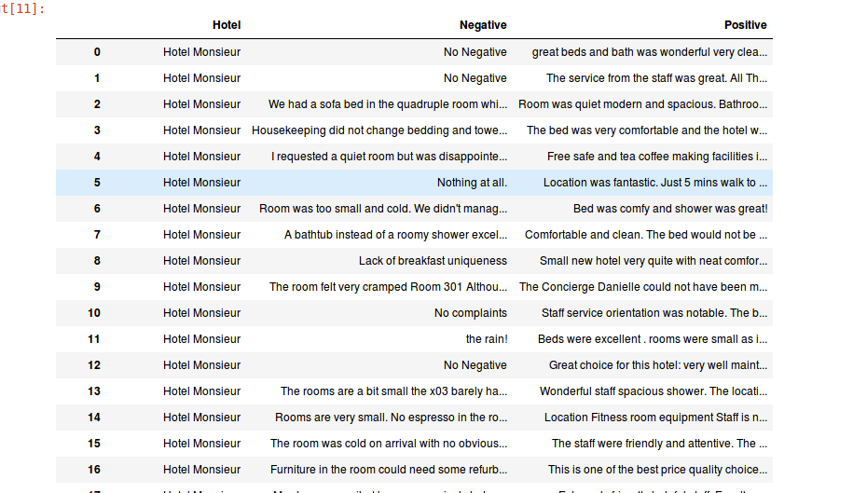
Data Set

Slide 5
Approach
Separating the dataset w.r.t. hotels
Extracting the sentences
Named Entity Recognition (NER)
Sentence Polarity Calculation
Score the hotels according to the features
LOCATION, VALUE, ROOM, MEAL, FACILITY, SERVICE
Rank the hotels according to user’s preference

Slide 6
Training a Named Entity Recognizer
Recognizers are often task specific
Stanford NLP
Uses Conditional Random Fields (CRF)
For training a custom NE Recognizer, we need training data
Manually tagging commonly used entities

Slide 7
Improving the NE Recognizer
Practically impossible to manually tag each and every entity
The entities that are related often appear in the same sentence
Association Pattern Mining to improve the NE Recognizer
Removing the stop words and punctuations
Finding the associations of two entities that appear more than a threshold (2500)
Checking if one of them is already tagged
If yes, then tag the other one in the same Entity Class
Used apriori algorithm developed by Christian Borgelt

Slide 8
Comparison
Selected few sentences from the dataset randomly
 | NE Recognizer | NE Recognizer with Associations Mining
Precision | 0.6667 | 0.6875
Recall | 0.4545 | 0.5000
F1-Measure | 0.5405 | 0.5789

Slide 9
Hotels_Features Matrix
The matrix will be updated using the polarity of the sentences(VADER)
For hotel in hotels:
for sentence in sentences:
for tok, tag in NETagger.tag(sentence):
if(tag is not ‘O’):
Hotels_Features[hotel][tag] += polarity(sentence)
Dumped into a pickle file after matrix creation for future use

Slide 10
Scoring & Ranking the hotels
The hotel will be scored depending on the user’s preferences
For hotel in hotels:
for feature in preference:
Hotel_score += Hotels_Features[hotel][feature]
Score[Hotels_List[hotel]]
Rank the hotels according to the scores
Display top few recommendations

Slide 11
Evaluation Criteria
Mining test set for preferences
Evaluated recommender system on the basis of 4 criteria:
If the user gave rating ==10, then check whether it is top 20
If the user gave rating >9, then check whether it is in top 50
If the user gave rating >8, then check whether it is in top 100
If the user gave rating <7, then check whether it is in top 200 (It should not be)

Slide 12
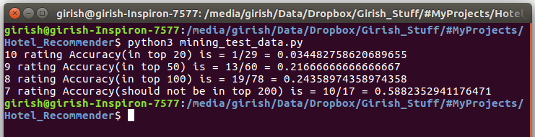
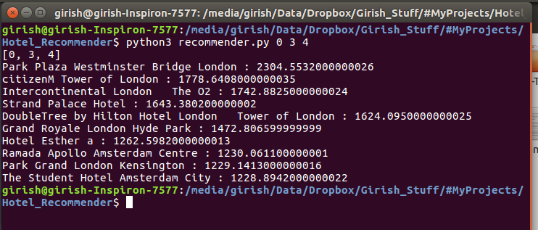
Results

Slide 13
Evaluation
 | Total reviews with specified rating | Hotels Found in top list | Accuracy
Rating == 10 | 29 | 1 | 3.45 %
Rating > 9 | 60 | 13 | 21.67 %
Rating > 8 | 78 | 19 | 24.36 %
Rating < 7 | 17 | 5 | 58.82 %

Slide 14
Analysis & Drawbacks
Large number of hotels are all over Europe
More attributes should be involved while evaluating the system
Comparing with only the hotels in that area to be fair
Uncertainty in Natural Language
Eg. Everything was great. There was nothing bad
Hotel with this review will be scored ‘0’ as no entity was tagged
Incomplete sentences make it hard for polarity calculation
Setting a base value to all negative/positive reviews

Slide 15
Improvements
Association pattern mining might tag some irrelevant entities
Word2vec - the NE Recognizer can be improved with less training
Sentence Polarity
Domain specific polarity calculation is a challenge
Eg. Many stains on the carpet of the bedroom yuk!
Eg. And a long human hair between the bedsheet and the mattress.
Compare with other sentiment analyzers
FastText, SentiStrength etc.

Slide 16
References
https://www.kaggle.com/jiashenliu/515k-hotel-reviews-data-in-europe
https://www.booking.com/
Stanford NLP - https://nlp.stanford.edu/software/CRF-NER.shtml
Apriori implementation - http://www.borgelt.net//apriori.html
VADER Sentiment - https://github.com/cjhutto/vaderSentiment
Word2vec - Hutto, C.J. & Gilbert, E.E. (2014). VADER: A Parsimonious Rule-based Model for Sentiment Analysis of Social Media Text. Eighth International Conference on Weblogs and Social Media (ICWSM-14). Ann Arbor, MI, June 2014. https://arxiv.org/abs/1301.3781
FastText - A. Joulin, E. Grave, P. Bojanowski, T. Mikolov, Bag of Tricks for Efficient Text Classification https://arxiv.org/abs/1607.01759

